Slide 1
A First Book of ANSI C Fourth Edition
Chapter 14
Additional Capabilities

Slide 2
Objectives
Additional Features
Bit Operations
Macros
Command-Line Arguments
Common Programming and Compiler Errors

Slide 3
Additional Features
The typedef declaration statement
Conditional preprocessor directives
Enumerated constants
Conditional expressions
The goto statement

Slide 4
The typedef Declaration Statement
typedef permits constructing alternate names for an existing C data type name
typedef double REAL; makes the REAL an alias for double
REAL val; is equivalent to double val;
typedef does not create a new data type
The equivalence produced by typedef can frequently be produced equally well by #define
typedef processed by the compiler
#define processed by the preprocessor

Slide 5
The typedef Declaration Statement (continued)
Another example:
typedef int ARRAY[100];
ARRAY first, second;
Equivalent to the two definitions int first[100]; and int second[100];
As another example:
typedef struct
{
char name[20];
int idNum;
} empRecord;
empRecord employee[75];

Slide 6
Conditional Preprocessor Directives
#ifndef and #ifdef permit conditional compilation in that the statements immediately following these directives, up to an #else or #endif, are compiled only if the condition is true, whereas the statements following the #else are compiled only if the condition is false
For example,
#ifndef condition
compile the statements placed here
#else
compile the statements placed here
#endif

Slide 7
Conditional Preprocessor Directives (continued)
The #else directive is optional
#ifndef is the most frequently used conditional preprocessor directive
Its most common usage is in the form
#ifndef header-file
#include <header-file>
#endif
For example:
#ifndef stdio.h
#include <stdio.h>
#endif

Slide 8
Enumerated Constants
Set of related integer values can be equated to an equivalent set of constants using an enumerated list
enum {Mon, Tue, Wed, Thr, Fri, Sat, Sun};
By default, the first enumerated name in an enumerated list has a value of 0
The enumeration above is equivalent to:
#define Mon 0
#define Tue 1
#define Wed 2
…

Slide 9
Enumerated Constants (continued)
To specify the value of the first enumerated name:
enum {Mon = 1, Tue, Wed, Thr, Fri, Sat, Sun};
Any integer constant can be equated to enumerated names; they need not be in sequence, and an optional enumerated list name can be used
enum escsequences {BELL = '\a',BACKSPACE = '\b',NEWLINE = '\n', RETURN = '\r', TAB ='\t'};
Enumerated constants can be any valid user-created identifier, but each name must be unique
OK for two constants to be equated to the same integer value

Slide 10
Conditional Expressions
A conditional expression uses the conditional operator, ?: and provides an alternate way of expressing a simple if-else statement
expression1 ? expression2 : expression3
For example, the if-else statement
if (hours > 40)
rate = 0.045;
else
rate = 0.02;
Can be replaced with
rate = (hours > 40) ? 0.045 : 0.02;
?: is unique in C in that it is a ternary operator

Slide 11
Conditional Expressions (continued)
Conditional expressions are only useful in replacing if-else statements when the expressions in the equivalent if-else statement are not long or complicated
For example, the statement maxVal = a > b ? a : b; is a one-line statement that assigns the maximum value of the variables a and b to maxVal
A longer, equivalent form of this statement is
if (a > b)
maxVal = a;
else
maxVal = b;

Slide 12
The goto Statement
goto provides an unconditional transfer of control to some other statement in a program
goto label;
label is any unique name chosen according to the rules for creating variable names
For example,
if (denom == 0.0)
goto err;
else
result = num /denom;
.
.
err: printf("Error: Attempted Division by Zero");

Slide 13
The goto Statement (continued)
Generally, it is much easier to call an error routine for unusual conditions or use a break statement if this is necessary, rather than use a goto
Theoretically, a goto is never required because C’s normal structures provide sufficient flexibility to handle all possible flow control requirements
gotos tend to complicate programs
Using even one goto statement in a program is almost always a sign of bad programming structure

Slide 14
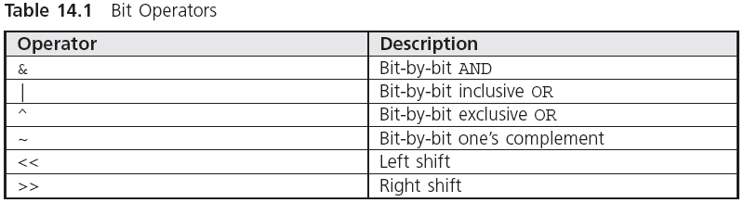
Bit Operations
https://www.programiz.com/c-programming/bitwise-operators
https://www.studytonight.com/post/masking-in-c-language

Slide 15

The AND Operator
& causes a bit-by-bit AND comparison between its two operands
AND operations are extremely useful in masking, or eliminating, selected bits from an operand
For example,
The 0s in op2 effectively mask the respective bits in op1, while the ones in op2 filter the respective bits in op1 through with no change in their values
In this example, op2 is called a mask

Slide 16
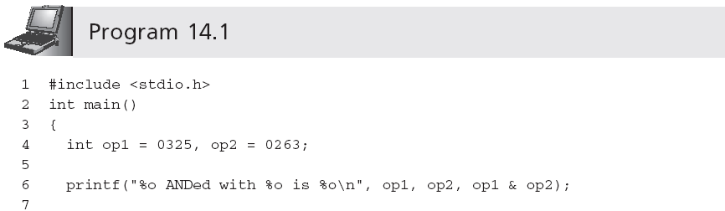
The AND Operator (continued)
Program 14.1 produces the following output:
325 ANDed with 263 is 221

Slide 17

The Inclusive OR Operator
The result of an inclusive OR (|) bit comparison is 1 if either bit is a 1; otherwise the result is a 0
Inclusive OR operations are extremely useful in forcing selected bits to take on a 1 value or for passing through other bit values unchanged
For example,
ORing with a 0 has the same effect as ANDing with a 1

Slide 18
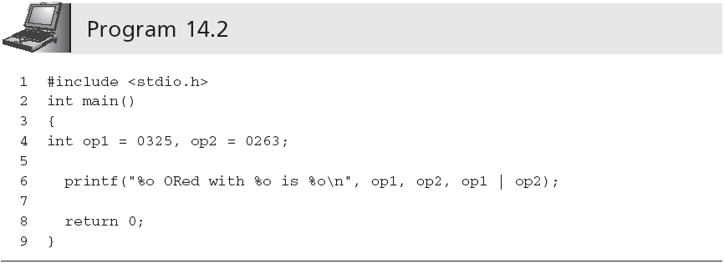
The Inclusive OR Operator (continued)
Program 14.2 produces the following output:
325 ORed with 263 is 367

Slide 19

The Exclusive OR Operator
The result of an exclusive OR (^) comparison is 1 if one and only one of the bits being compared is a 1; otherwise the result is 0
An exclusive OR operation can be used to create the opposite value, or complement, of any individual bit in a variable
For example,

Slide 20
The Complement Operator
~ is the unary complement operator
If op1 contains the binary number 11001010, ~op1 replaces this number with 00110101
~ is used to force any bit in an operand to 0, independent of the number of bits used to store it
op1 &= ~07; sets the last 3 bits of op1 to 0
This statement is equivalent to the following:
op1 = op1 & 0177770; /* if an int has 16 bits */
op1 = op1 & 037777777770; /* if it has 32 bits */
This makes the program portable between machines using different integer storage sizes

Slide 21
Different-Sized Data Items
When &, |, and ^ are used with operands of different sizes, the shorter operand is increased in bit size to match the size of the larger operand
When extending signed numbers, the original leftmost bit is reproduced in the additional bits that are added to the number

Slide 22
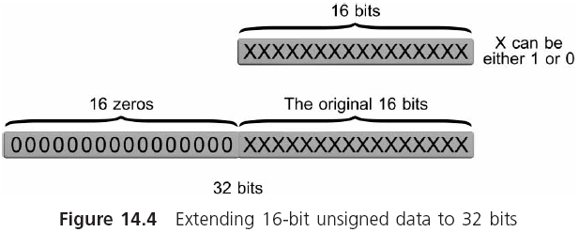
Different-Sized Data Items (continued)

Slide 23
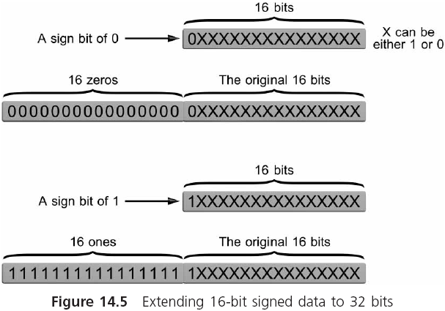
Different-Sized Data Items (continued)

Slide 24
The Shift Operators
The left shift operator, <<, causes the bits in an operand to be shifted to the left by a given amount
For example, p1 = op1 << 4;
For unsigned integers, each left shift corresponds to multiplication by 2
Also true for signed numbers using two’s complement representation, as long as the leftmost bit does not switch values

Slide 25
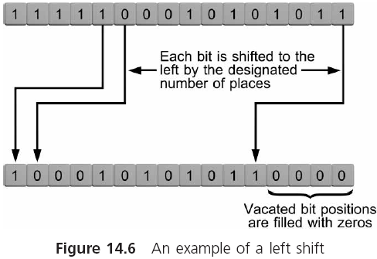
The Shift Operators (continued)

Slide 26
The Shift Operators (continued)
The right shift operator, >>, causes the bits in an operand to be shifted to the right by a given amount
For example,
op1 = op1 >> 3;

Slide 27
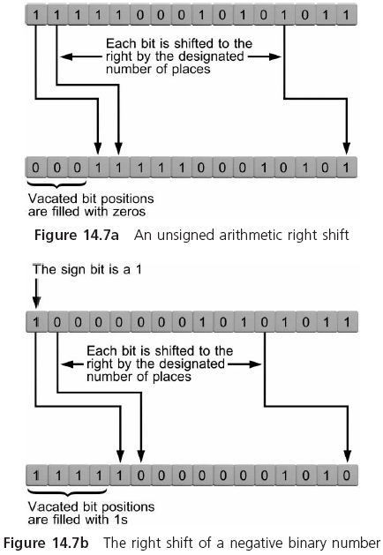
The Shift Operators (continued)

Slide 28
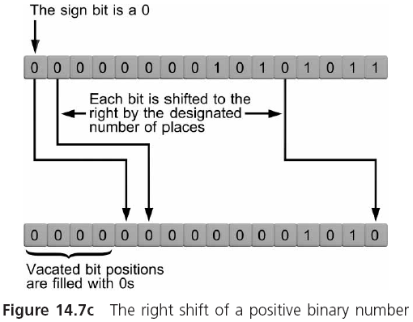
The Shift Operators (continued)

Slide 29
The Shift Operators (continued)
The type of fill shown in Figures 14.7b and 14.7c, where the sign bit is reproduced in vacated bit positions, is known as an arithmetic right shift
In an arithmetic right shift, each single shift to the right corresponds to a division by 2
Some computers automatically fill the vacated bits with 0s; this type of shift is known as a logical shift
For positive signed numbers, where the leftmost bit is 0, both arithmetic and logical right shifts produce the same result

Slide 30
Macros
In its simplest form, the #define preprocessor is used to equate constants and operators to symbolic names
#define SALESTAX 0.05
The substitutions are made by the C preprocessor just prior to program compilation
C places no restrictions on the equivalences that can be established with the #define statement
When the equivalence consists of more than a single value, operator, or variable, the symbolic name is referred to as a macro

Slide 31
Macros (continued)
For example, the equivalence established by the statement… #define FORMAT "The answer is %f\n"
…enables us to write the statement
printf(FORMAT, 15.2);
The compiler always receives the expanded version after the text has been inserted in place of the symbolic name by the preprocessor

Slide 32
Macros (continued)
Equivalences can use arguments
#define SQUARE(x) x * x
y = SQUARE(num); is expanded to y = num * num;
Advantage: since the data type of the argument is not specified, the macro can be used with any data type argument
Be careful: val = SQUARE(num1 + num2); is expanded to val = num1 + num2 * num1 + num2;
Solution: use #define SQUARE(x) (x) * (x)

Slide 33
Macros (continued)
Macros are extremely useful when the calculations or expressions they contain are relatively simple
A macro definition can be continued on a new line by using a \
The advantage of using a macro instead of a function is an increase in execution speed
No execution time loss due to the call and return procedures required by a function
Disadvantage: the increase in required program memory space when a macro is used repeatedly
Each time a macro is used, the complete macro text is reproduced and stored as part of the program
A function is stored in memory only once

Slide 34
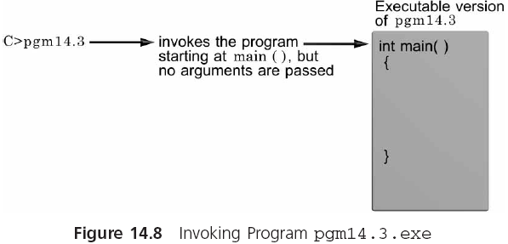
Command-Line Arguments

Slide 35
Command-Line Arguments (continued)
You can use command-line arguments to pass arguments to a main() function
C:>pgm14.3 three blind mice
To standardize arguments passing to main(), only two items are allowed: a number and an array
The number is an integer variable, which must be named argc (short for argument counter)
The array is a one-dimensional list, which must be named argv (short for argument values)

Slide 36

Command-Line Arguments (continued)

Slide 37
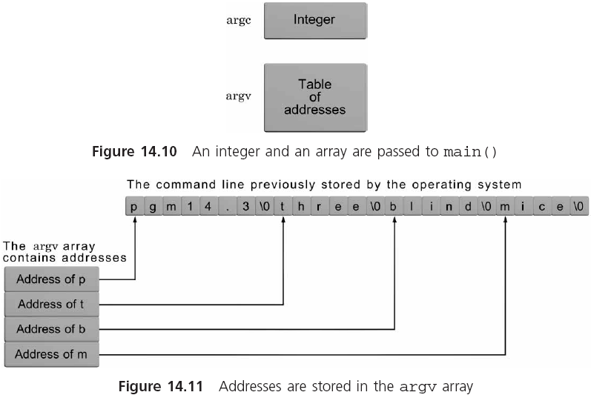
Command-Line Arguments (continued)

Slide 38
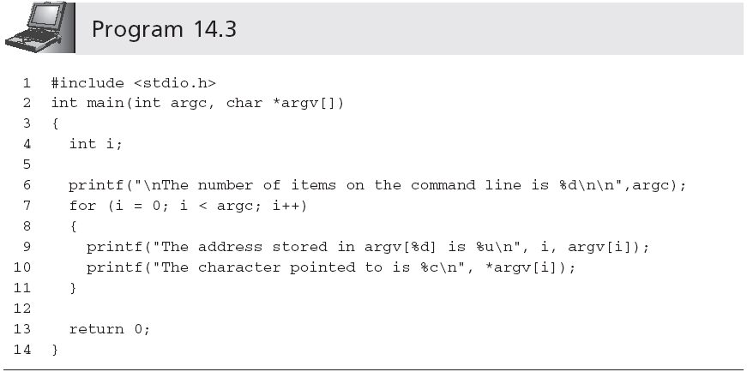
Command-Line Arguments (continued)

Slide 39
Command-Line Arguments (continued)
If the executable version of Program 14.3 is named pgm14.3.exe, a sample output for the command line pgm14.3 three blind mice is:
The number of items on the command line is 4
The address stored in argv[0] is 3280036
The character pointed to is p
The address stored in argv[1] is 3280044
The character pointed to is t
The address stored in argv[2] is 3280050
The character pointed to is b
The address stored in argv[3] is 3280056
The character pointed to is m

Slide 40
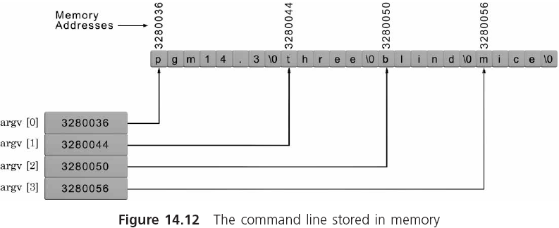
Command-Line Arguments (continued)

Slide 41
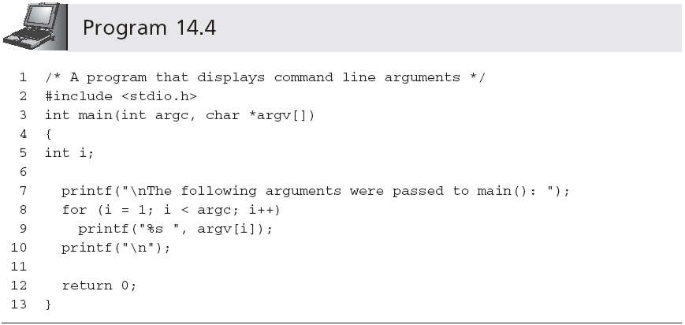
Command-Line Arguments (continued)

Slide 42
Common Programming Errors
Forgetting that enumerated constants are a set of symbolic constants that equate to integers
Using the relational operators, > and <, in place of the shift operators, >> and <<
Forgetting that each argument passed to main() is passed as a string value

Slide 43
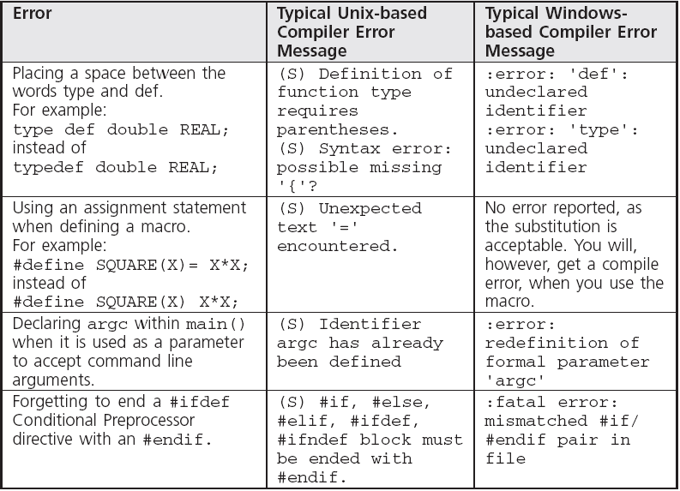
Common Compiler Errors

Slide 44
Summary
A typedef statement creates synonym names, which are known as aliases, for any C data type name
A conditional expression provides an alternate way of expressing a simple if-else statement.
C also provides a goto statement
Individual bits of character and integer variables and constants can be manipulated using C’s bit operators
The AND and inclusive OR operators are useful in creating masks

Slide 45
Summary (continued)
When AND and OR are used with operands of different sizes, the shorter operand is always increased in bit size to match the size of the larger
The shift operators produce different results depending on whether the operand is a signed or an unsigned value
Using the #define command, complete expressions can be equated to symbolic names
Arguments passed to main() are termed command-line arguments

